Slide 1
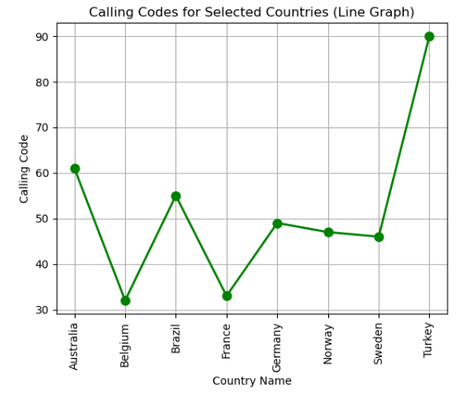
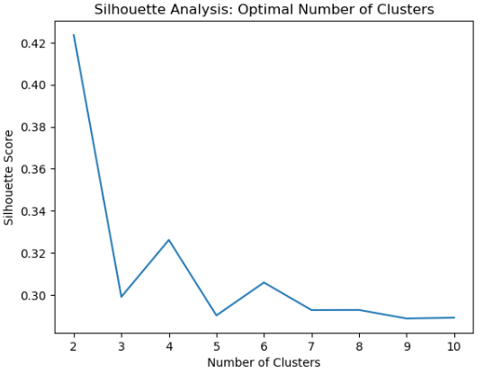
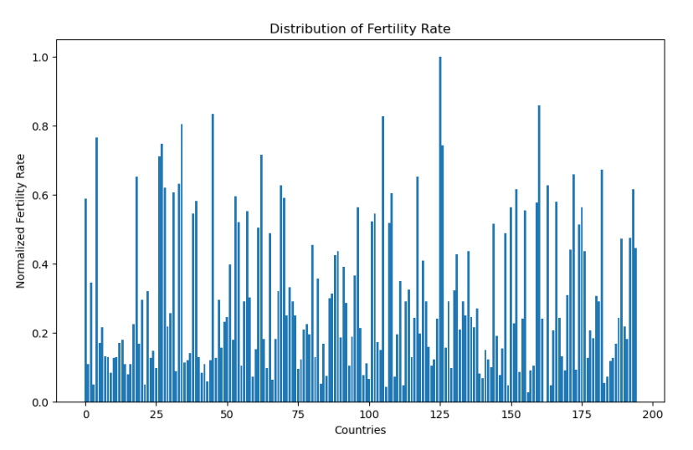
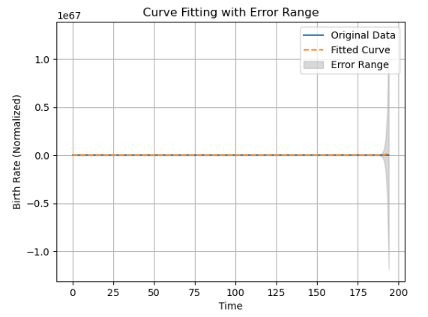
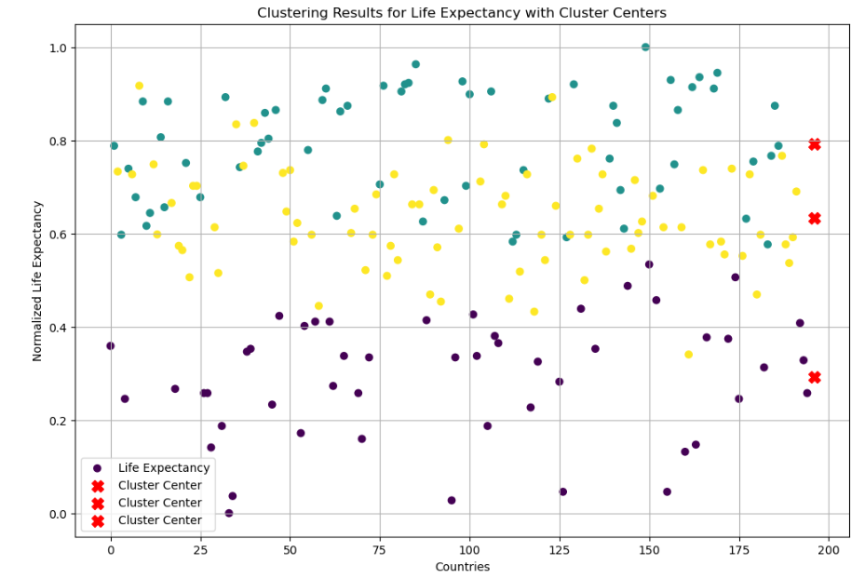
Vital Metrics Across Nations from Birth Rates to Healthcare Access
Introduction
We explore a vast array of worldwide data sets in this investigation to uncover crucial information about the interrelated dynamics of birth rates, access to healthcare, and important demographic markers. This voyage aims to reveal complex patterns and trends in a variety of countries, from the microcosm of birth rates to the macro view of healthcare facilities.
An analysis plot of silhouettes was produced using the Elbow Method and K-Means Clustering to identify patterns in the global data for 2023.
International Connectivity Calling Codes of Selected Countries
Selected for their diverse geographical locations, cultural richness, and significant global influence, these countries serve as representative nodes in the international network, offering a comprehensive snapshot of communication dynamics across continents.
Bar Graph Representing Global Fertility Rate for the Year 2023
Temporal Evolution of Birth Rate Fitting and Uncertainty
Clustering Analysis of Life Expectancy
Conclusion
By employing clustering and curve-fitting methods, this study reveals important patterns and trends in intricate datasets, promoting a sophisticated comprehension of global measurements. Curve fitting untangles temporal trends to allow for future result predictions, while clustering clarifies national similarities to direct targeted interventions. The combination of these approaches strengthens evidence-based decision-making and encourages a proactive strategy for tackling global issues.
Name: Jyothsna Chandaluri
Student id:22068546
Github link:
The x-axis displays the variation in life expectancy among the various countries, with each point representing a particular country. This label gives viewers a reference for analyzing the data's clustering patterns and makes it clear to them that the scatter plot shows how nations are dispersed according to life expectancy.

